Slide 1
Modern NLP with Large Language Models: Techniques, Tools, and Challenges
Md Shahidul Salim
Graduate Research Assistant,
University of Massachusetts Lowell
Date: 26 June 2025

Slide 2
Agenda
What Are Large Language Models (LLMs)?
How Do They Work?
Applications Across Industries
Tools & Ecosystem Overview
Customizing and Using LLMs
Challenges and Limitations
Q&A

Slide 3
Natural Language Processing and Large Language Models
NLP is a field of linguistics and machine learning focused on understanding everything related to human language.
The aim of NLP tasks is not only to understand single words individually, but to be able to understand the context of those words.
LLMs (Large Language Models) like Llama, GPT, and Claude are powerful NLP models trained on vast data, capable of handling diverse language tasks with minimal fine-tuning.

Slide 4
List of common NLP tasks
Classifying whole sentences(sentiment analysis)
Classifying each word in a sentence (POS tagging)
Generating text content
Extracting an answer from a text
Generating a new sentence from an input text

Slide 5
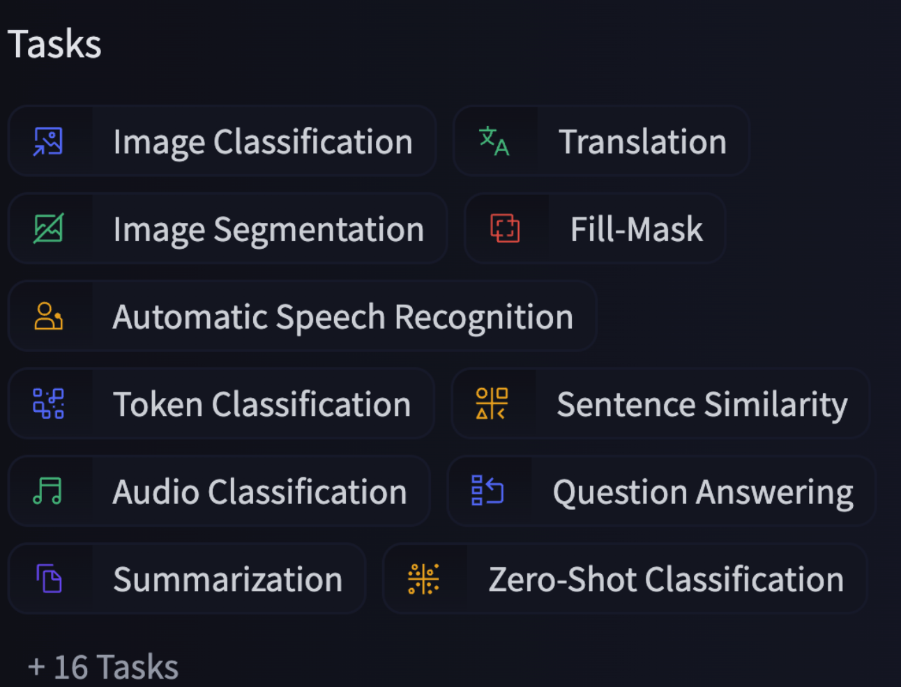
Example
https://colab.research.google.com/drive/1vYVzlMtV62EVDJEs3buVjOWq38ttDG4X?usp=sharing

Slide 6
LLMs (Large Language Models)
A powerful subset of NLP models characterized by their massive size, extensive training data, and ability to perform a wide range of language tasks with minimal task-specific training.
Models like the Llama, GPT, or Claude series are examples of LLMs that have revolutionized what’s possible in NLP.
Scale: They contain millions, billions, or even hundreds of billions of parameters (Qwen2.5 7B, Phi-4 14B)
General capabilities: They can perform multiple tasks without task-specific training
In-context learning: They can learn from examples provided in the prompt

Slide 7
Why Large Language Models Matter
🚀 Human-like language generation
🏥 Impact on industries: Healthcare, Law, Education, Finance
🤖 New era of AI-human collaboration
🛠️ Tools for creativity, productivity, automation

Slide 8
Transformers
LLMs are built using the Transformer architecture.
LLMs like GPT, BERT, T5, LLaMA, Claude, PaLM, etc., are specific implementations of the Transformer architecture.
The Transformer architecture was introduced in June 2017.
GPT-like (also called auto-regressive Transformer models)
Generate text one token at a time, where each new token is predicted based on the previous tokens.
BERT-like (also called auto-encoding Transformer models)
Understand the full context of a sentence by encoding the input and learning to reconstruct or predict missing parts.(both left and right context simultaneously)
T5-like (also called sequence-to-sequence Transformer models)
Transform one sequence into another

Slide 9
How Transformer Models Learn Language
Pretraining: Self-Supervised Learning Models: GPT, BERT, T5, etc.
Trained on: Massive raw text data (e.g., books, websites)
Learning Type:
Self-supervised
→ No manual labels needed
→ Objective is derived from the data itself
Goal: Learn general patterns of language (syntax, grammar, word relationships)
🗣️ “The model teaches itself using the structure of the text!”

Slide 10
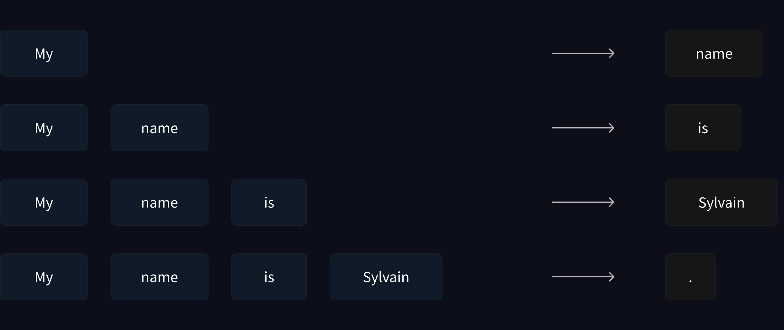
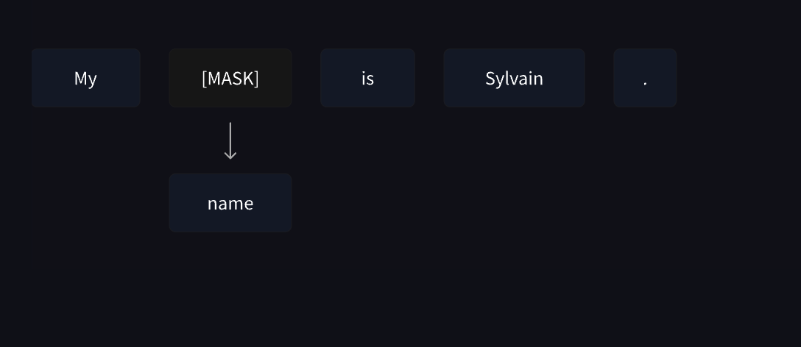
Two Main Ways They Learn Language
1) Causal Language Modeling (like GPT)
The model sees a sentence like: “The dog chased the __”
It tries to guess the next word (maybe: “cat”).
It reads text from left to right, one word at a time.
2) Masked Language Modeling (like BERT)
The model sees a sentence like: “The [MASK] is blue.”
It tries to guess the masked word (maybe: “sky”).

Slide 11
Fine-Tuning: Supervised Learning
Why needed? Pretrained models understand language but aren’t optimized for specific tasks like Q&A, summarization, or translation.
Fine-tuning Process: ➤ Use human-labeled datasets ➤ Train the model on a specific task
Examples:
Sentiment Analysis
Medical Text Summarization
Chatbots
🧩 “Fine-tuning helps models go from knowing language to using it effectively.”

Slide 12
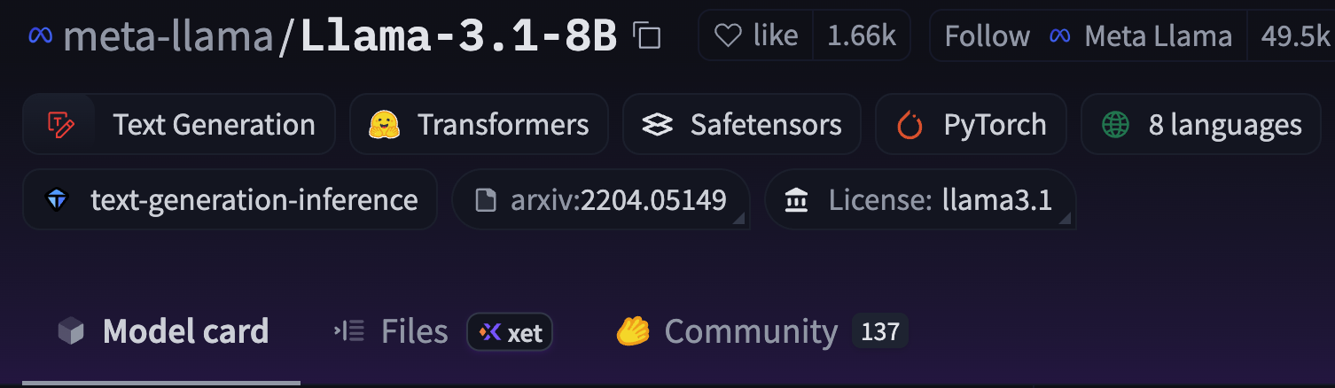
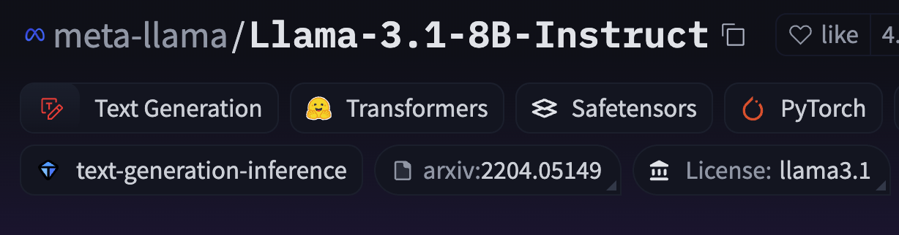
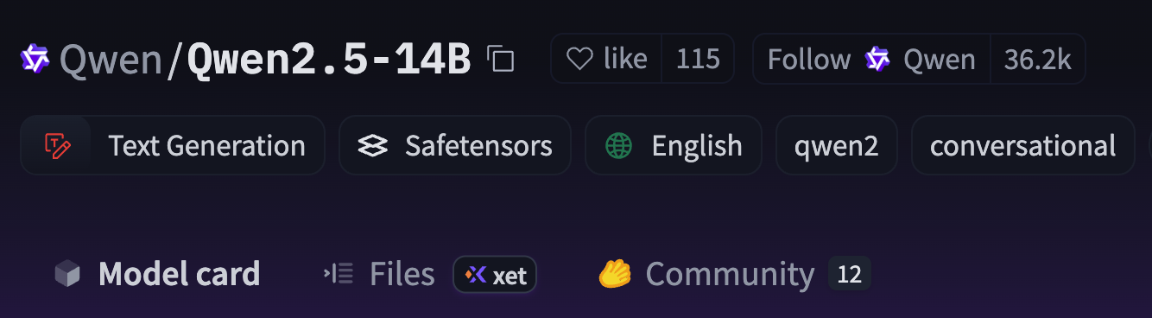
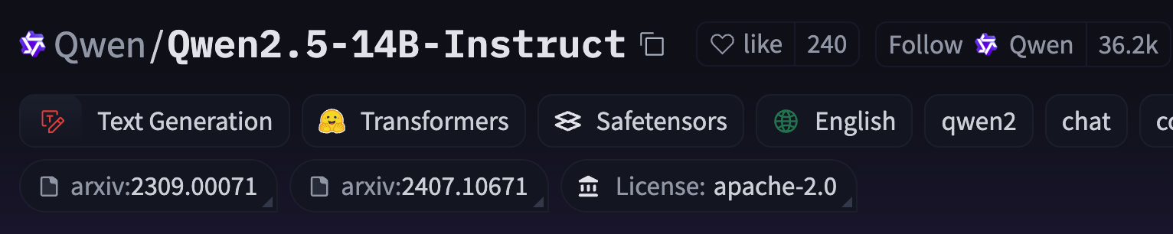

Slide 13
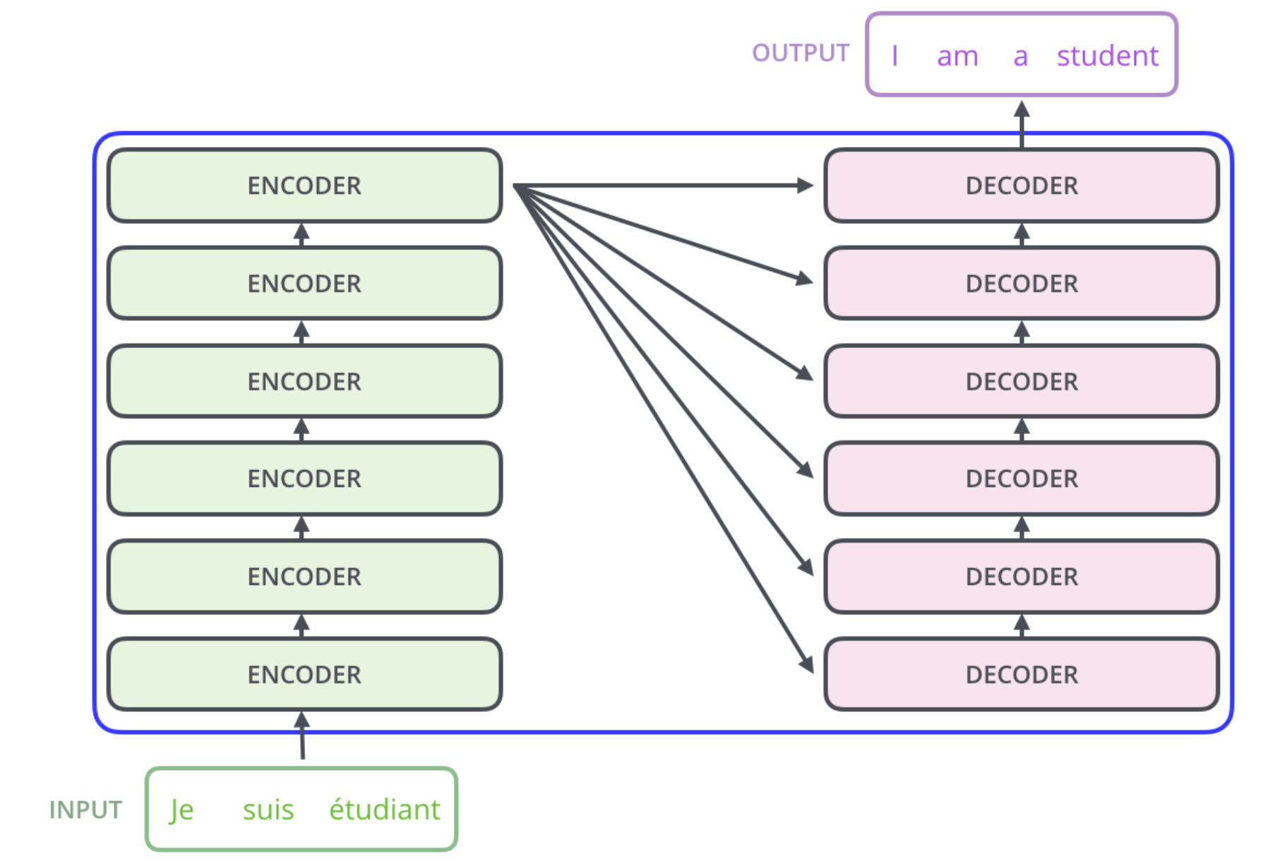
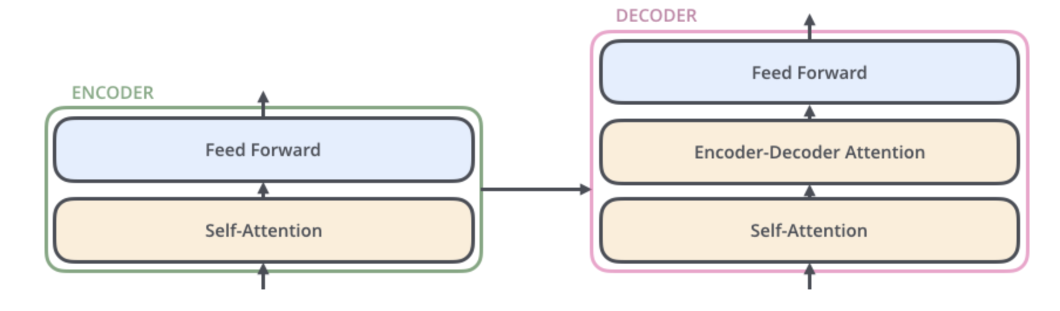
General Transformer architecture
Encoder-only models: Good for tasks that require understanding of the input, such as sentence classification and named entity recognition. Ex: BERT
Decoder-only models: Good for generative tasks such as text generation. Ex: GPT, Llama
Encoder-decoder models or sequence-to-sequence models: Good for generative tasks that require an input, such as translation or summarization. Ex: T5, BART

Slide 14
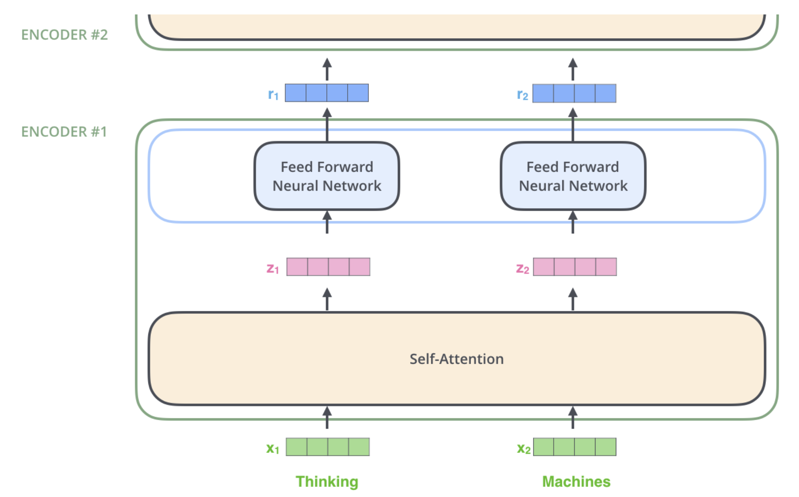
Self attention

Slide 15
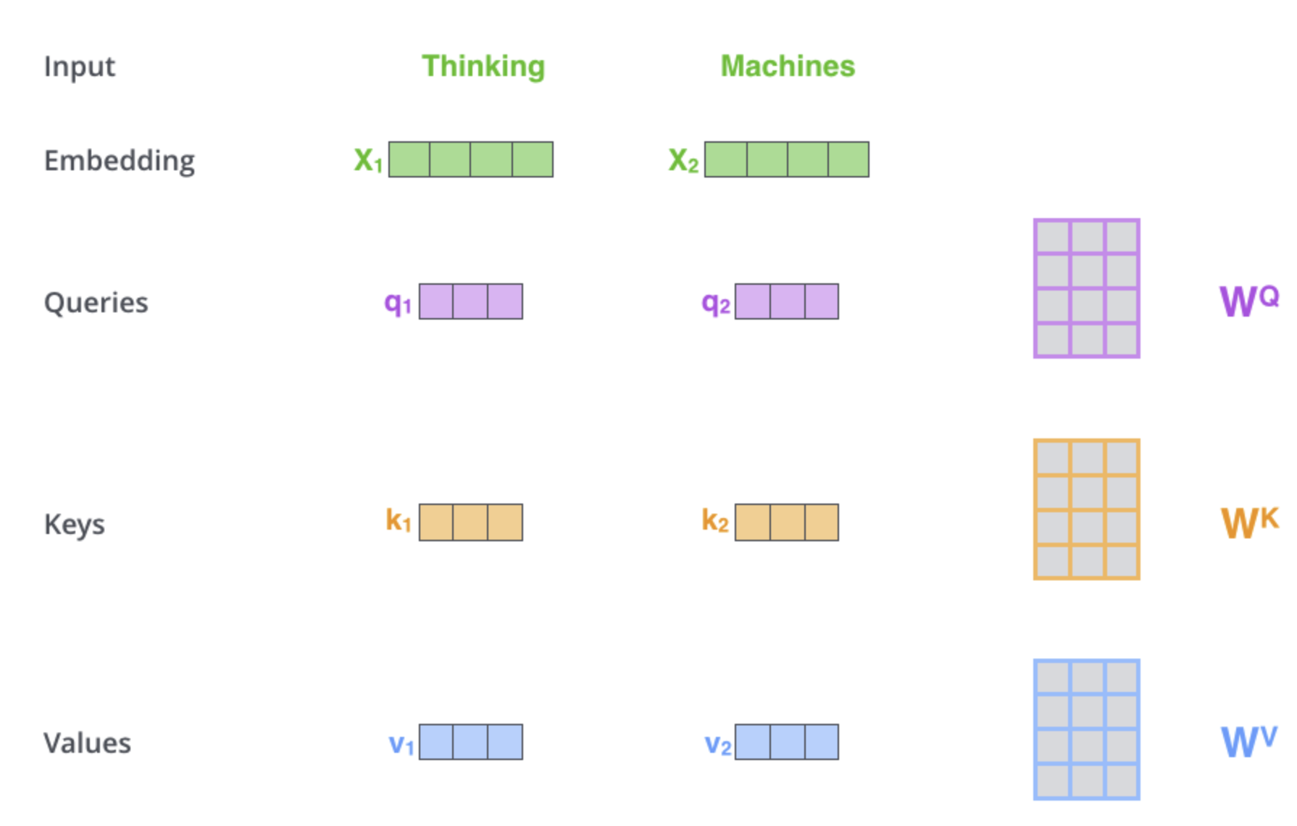
Self-Attention in Detail
The first step in calculating self-attention is to create three vectors from each of the encoder’s input vectors (in this case, the embedding of each word).

Slide 16
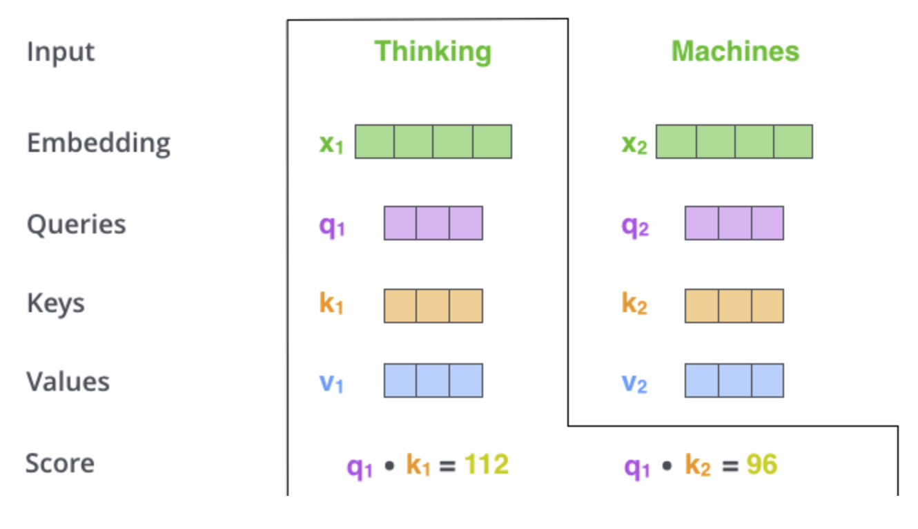
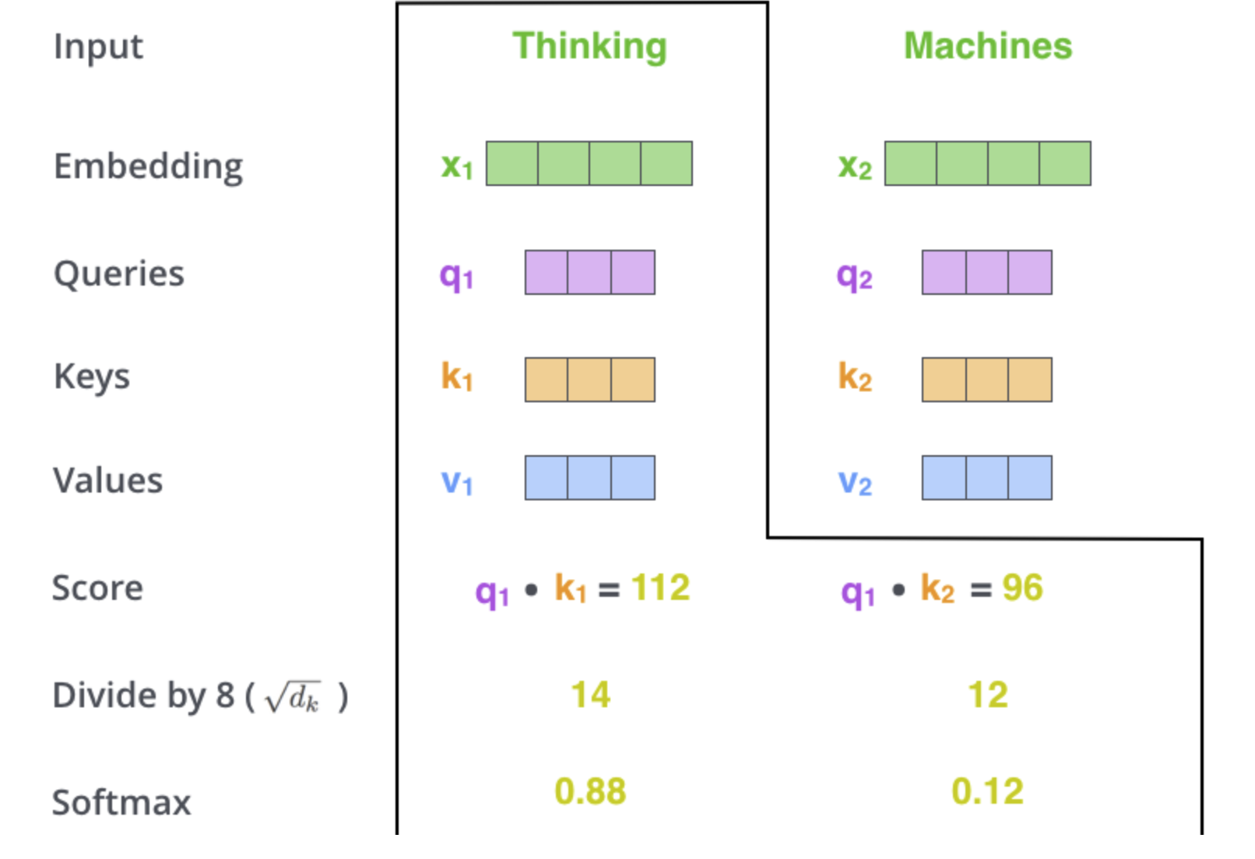
Self-Attention in Detail

Slide 17
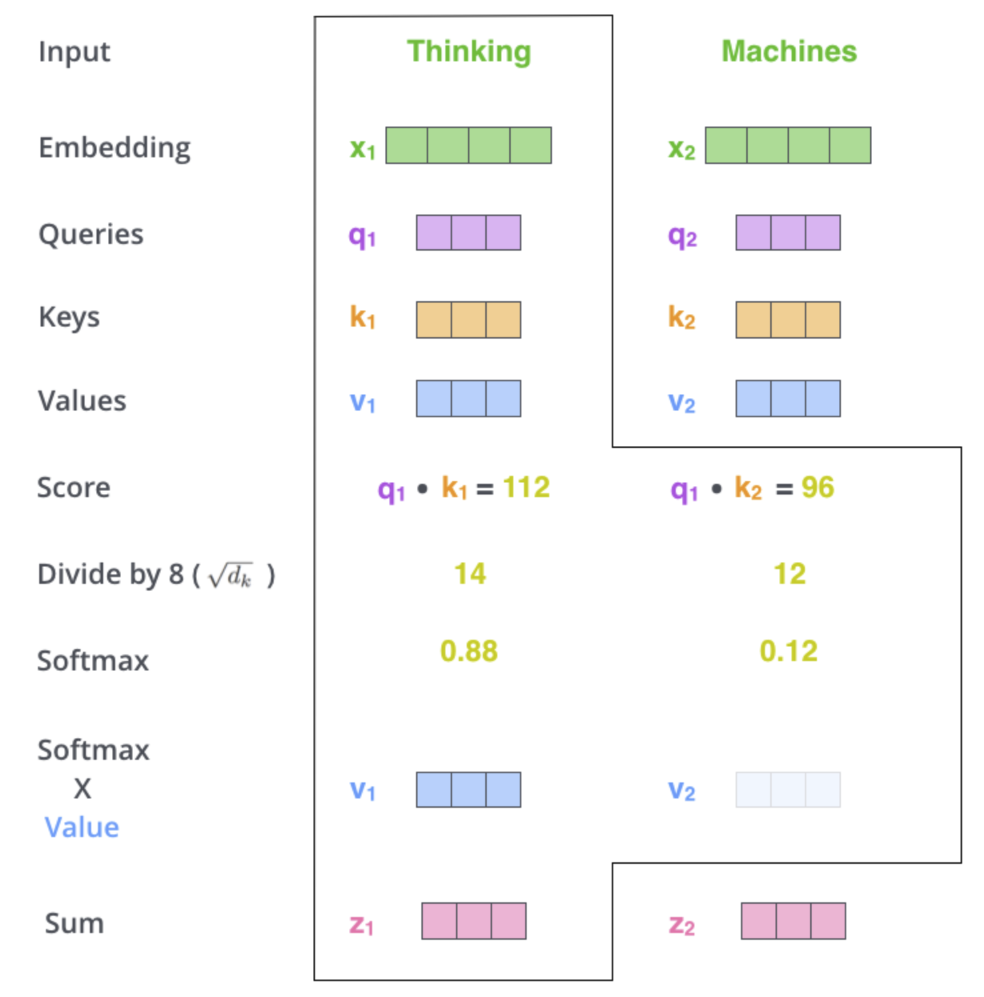
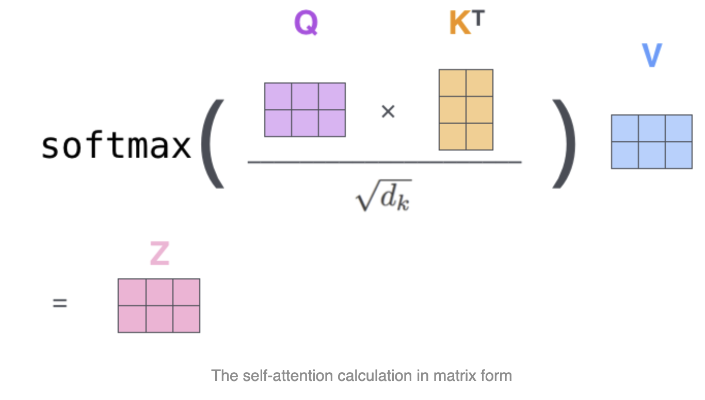

Slide 18
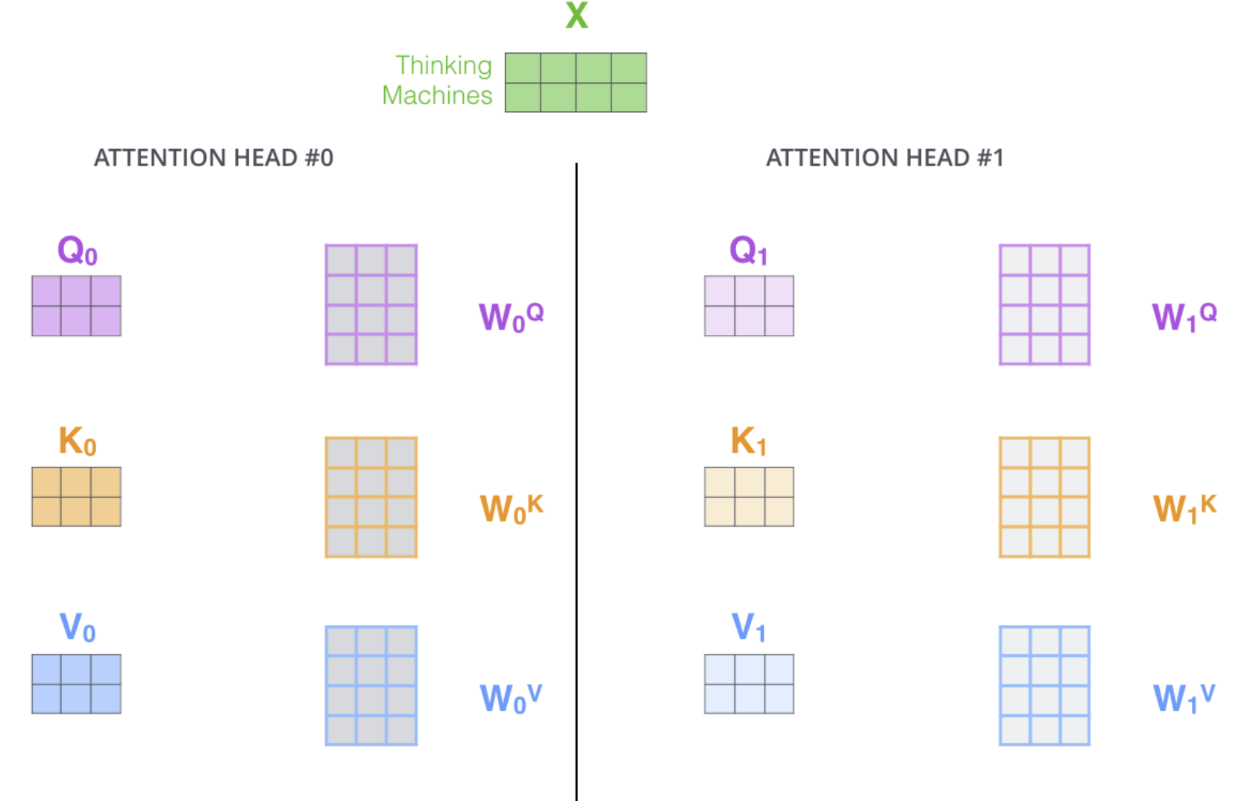
Multiple attention heads

Slide 19
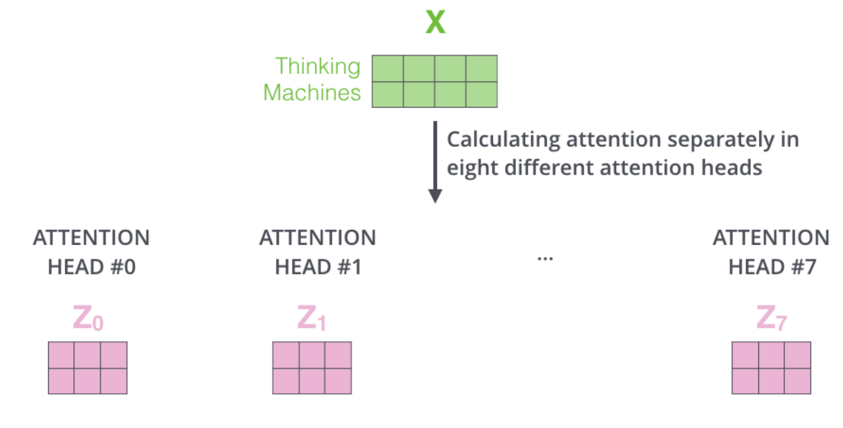
Eight different times with different weight matrices

Slide 20
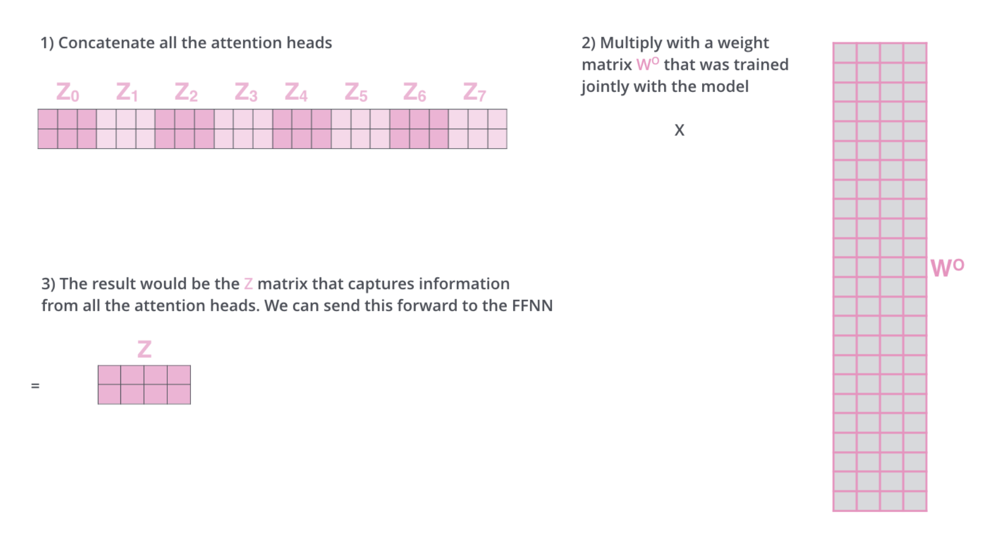
Multiply them by an additional weights matrix WO.

Slide 21
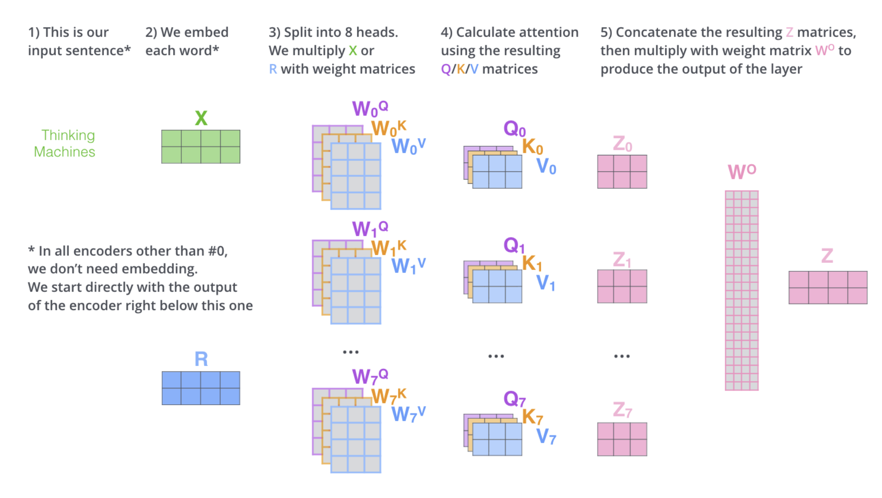
Full view of multi-headed self-attention

Slide 22
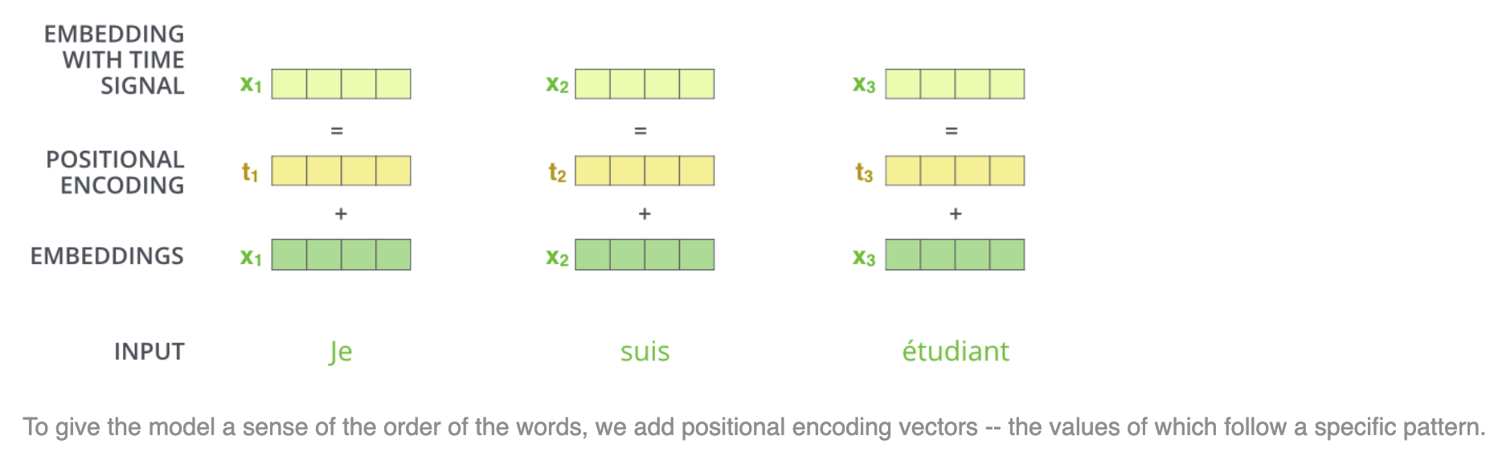
Representing The Order of The Sequence Using Positional Encoding

Slide 23
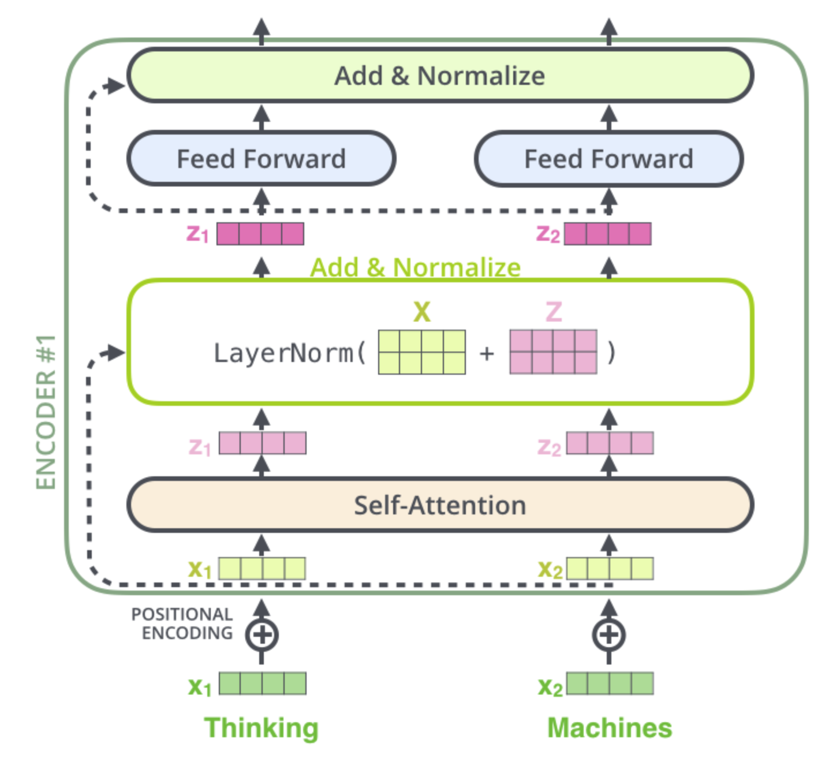
layer-normalization

Slide 24
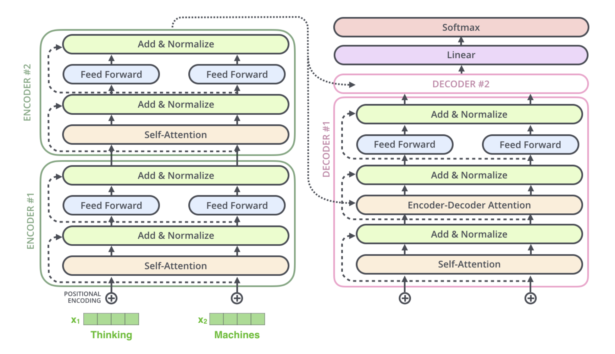
Encoder-decoder information pass

Slide 25

Decoder side
The output of the top encoder is then transformed into a set of attention vectors K and V.
These are to be used by each decoder in its “encoder-decoder attention” layer which helps the decoder focus on appropriate places in the input sequence.

Slide 26
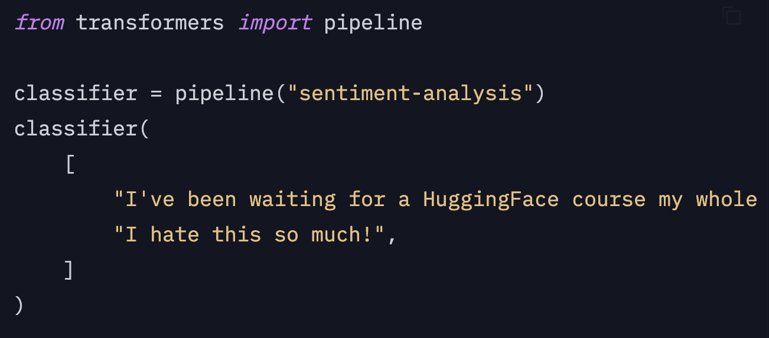
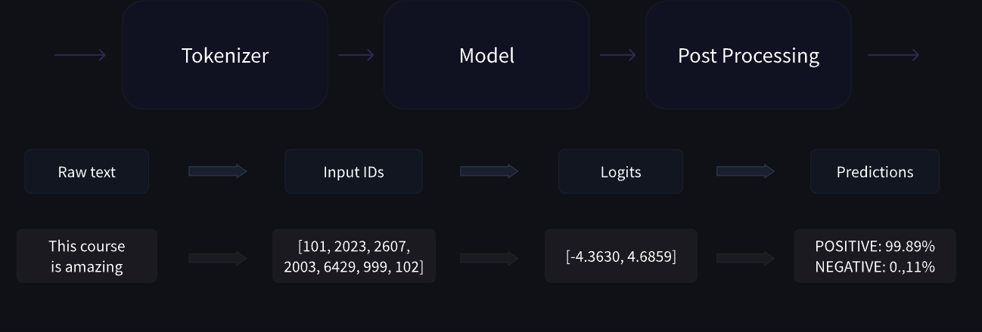
Behind the pipeline
Select the model and tokenizer
Splitting the input into words, subwords, or symbols (like punctuation) that are called tokens
Mapping each token to an integer
Adding additional inputs that may be useful to the model
https://colab.research.google.com/drive/1_1igzhcml_JC8ZDUoCZ4mFq91QQ8eKpM?usp=sharing

Slide 27
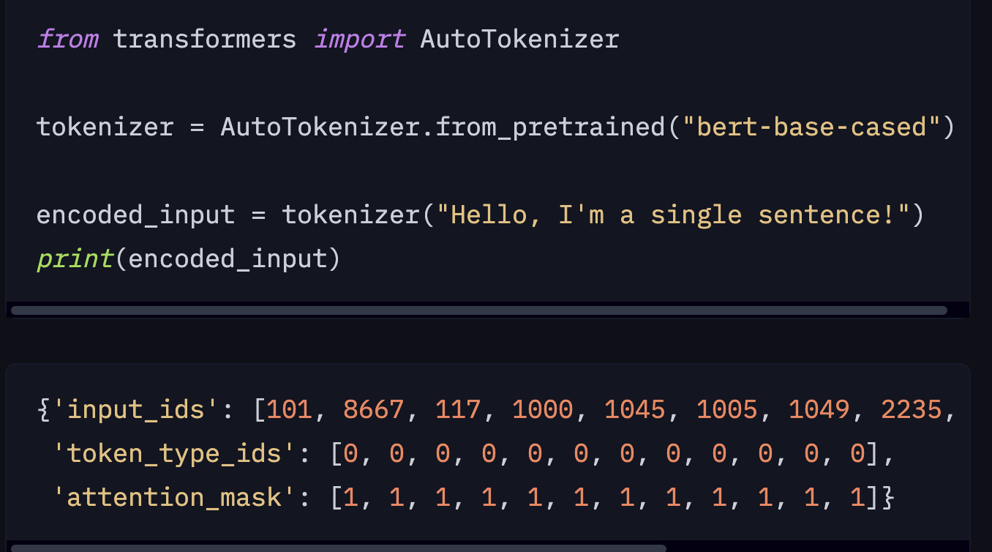
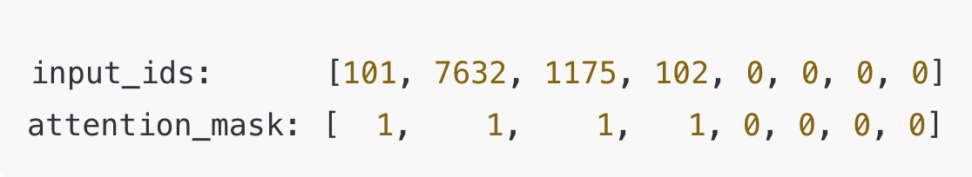
Tokenizers
Tokenizers convert text into numerical representations that NLP models can process.
Tokenization Methods
Word-based Tokenization
Character-based Tokenization
Subword based Tokenization
https://colab.research.google.com/drive/1RXcIhLUT3GftinupKR9YO43_PIklHGLL?usp=sharing

Slide 28
Tokenizers
Byte-level BPE, as used in GPT-2
WordPiece, as used in BERT
SentencePiece or Unigram, as used in several multilingual models

Slide 29
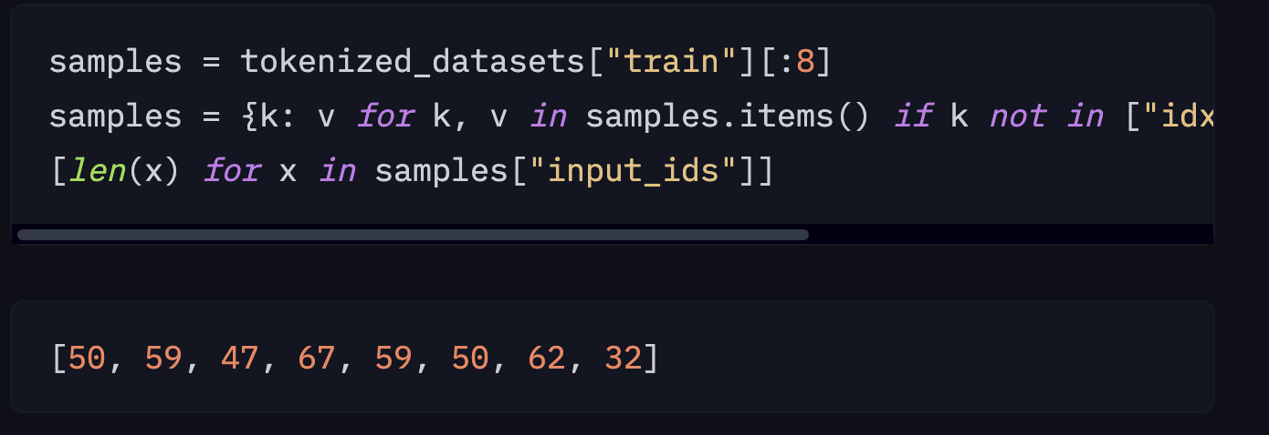
Fine-tuning a pretrained model
1) https://huggingface.co/models : select your model
2) Dynamic padding

Slide 30
LLM inference
https://ollama.com/
https://docs.vllm.ai/en/latest/
Hugging face
https://github.com/unslothai/unsloth
LM studio
GPU vram calculation
https://huggingface.co/settings/local-apps?fromRepo=QuantFactory/Qwen2.5-7B-GGUF
https://apxml.com/tools/vram-calculator

Slide 31
Inference Practice Code

Slide 32
LLM finetuning
https://github.com/hiyouga/LLaMA-Factory
https://axolotl.ai/
https://github.com/deepspeedai/DeepSpeed
https://github.com/unslothai/unsloth

Slide 33
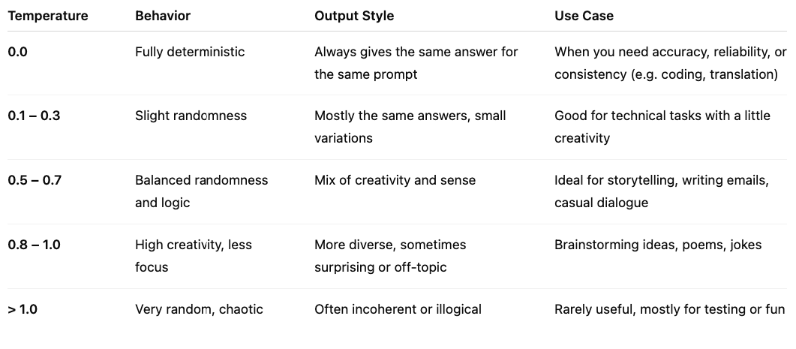
Temperature

Slide 34
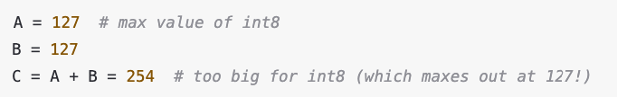
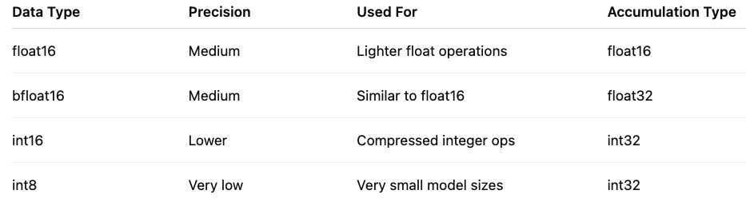
Quantization
A technique to reduce the computational and memory costs of running inference by representing the weights and activations with low-precision data types like 8-bit integer (int8) instead of the usual 32-bit floating point (float32).
Accumulation = Needs larger data types to avoid overflow or precision loss.

Slide 35
Quantization
AutoAWQ (https://docs.vllm.ai/en/latest/features/quantization/auto_awq.html)
BitsAndBytes (https://docs.vllm.ai/en/latest/features/quantization/bnb.html)
GGUF

Slide 36
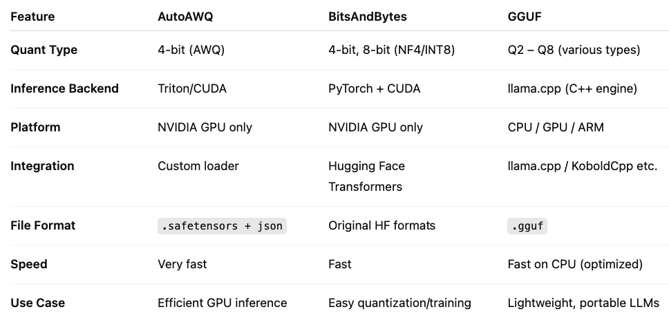
Difference

Slide 37
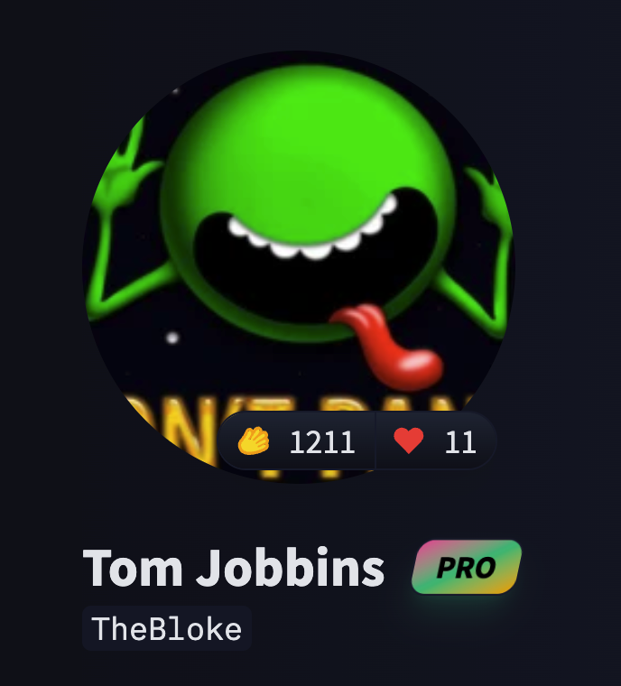
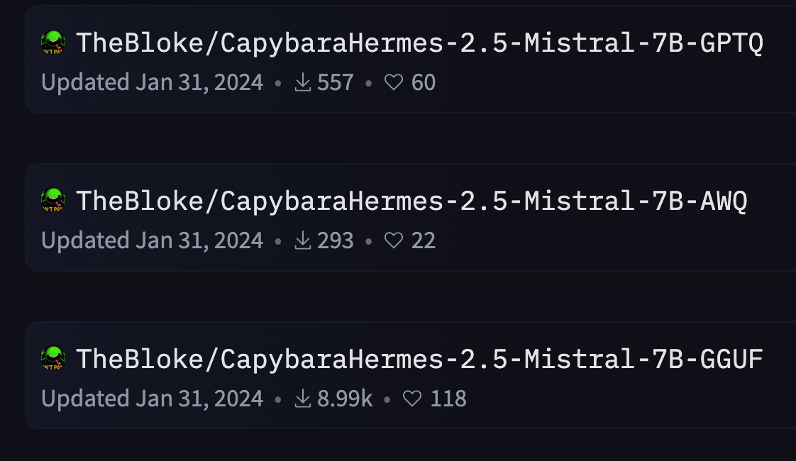
When to Use What?
Use AutoAWQ if you want maximum GPU inference speed for AWQ-compatible models on NVIDIA hardware.
Use BitsAndBytes if you're doing PyTorch-based model loading and want simple quantization with Hugging Face.
Use GGUF if you want portable, offline, and CPU-compatible inference (e.g., on laptops, mobile, Raspberry Pi).
Transformers supports the AWQ and GPTQ quantization algorithms and it supports 8-bit and 4-bit quantization with bitsandbytes.

Slide 38
Low-Rank Adaptation of Large Language Models Finetuning
A parameter-efficient fine-tuning technique that allows you to adapt a large pre-trained model to a downstream task without needing to update all of its parameters.
LoRA solves this by freezing the original weights of the pre-trained model and introducing small trainable matrices in certain layers.
PEFT from Hugging Face
QLoRA: Combines quantization with LoRA
LoRA with bitsandbytes: Optimized for low-bit training

Slide 39
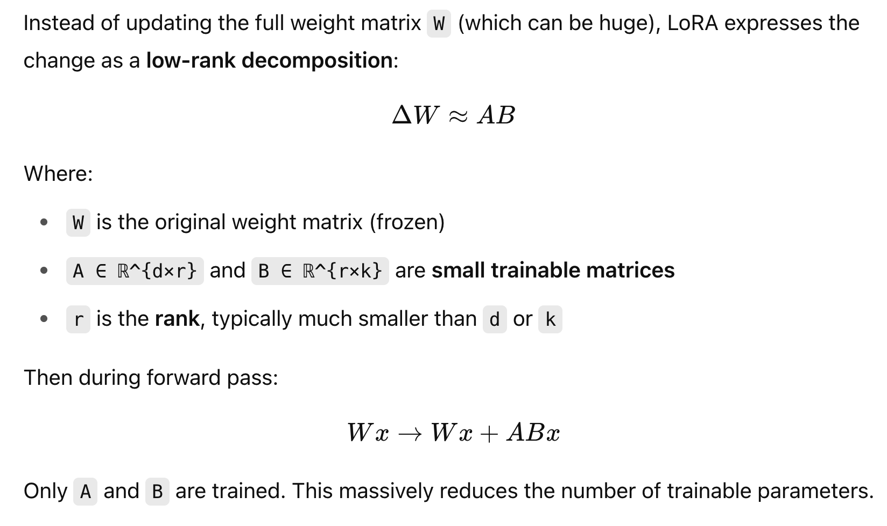
LoRa

Slide 40
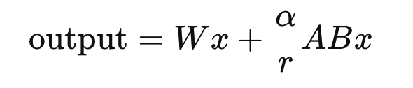
Parameters
r — Rank of the LoRA matrices
Controls the dimensionality of the low-rank matrices A and B.
Default values: Common values are 4, 8, or 16.
Higher r → more trainable parameters → potentially better performance but more memory usage.
Lower r → fewer parameters → more efficient but might underfit.
lora_alpha — Scaling factor
What it does: Scales the output of the LoRA adapter.
During training, the adapter output is scaled by:
Higher alpha = stronger contribution from the LoRA component.

Slide 41
Parameters
target_modules — Layers to insert LoRA into
What it does: Tells LoRA which parts of the model should be modified.
For transformers: ["q_proj", "v_proj"] or ["k_proj", "out_proj"]
lora_dropout — Dropout on the adapter
Applies dropout before the LoRA adapter output is added to the original model.
Helps regularize the model and avoid overfitting.
task_type — What kind of task is being fine-tuned
TaskType.CAUSAL_LM for GPT-like models (text generation)
TaskType.SEQ_2_SEQ_LM for T5-like models
TaskType.SEQ_CLS for classification

Slide 42
Finetuning using Unsloth ai
https://github.com/unslothai/unsloth

Slide 43
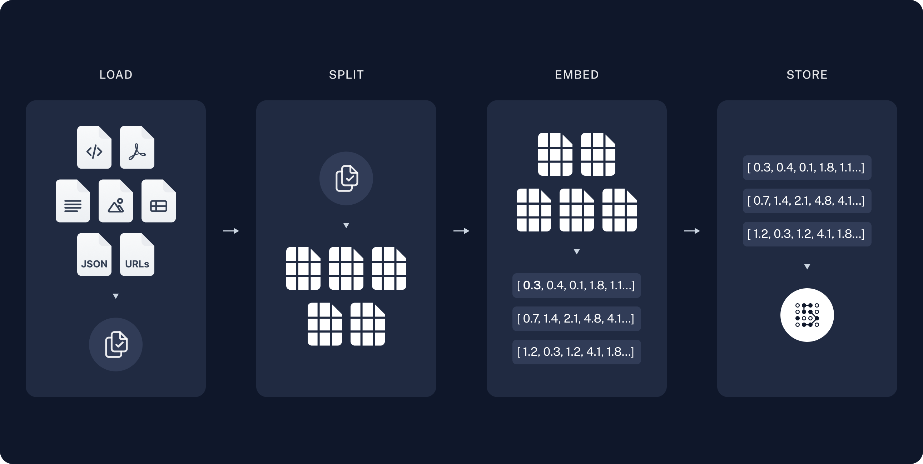
RAG (Retrieval augmented generation)

Slide 44
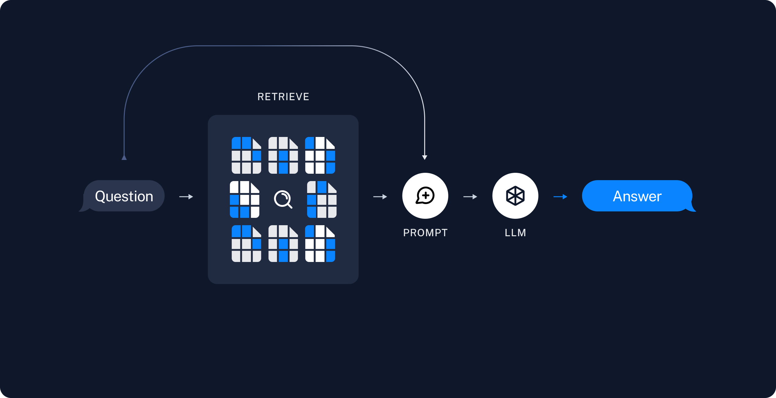
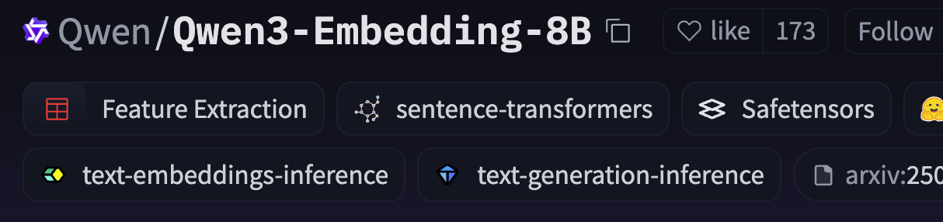
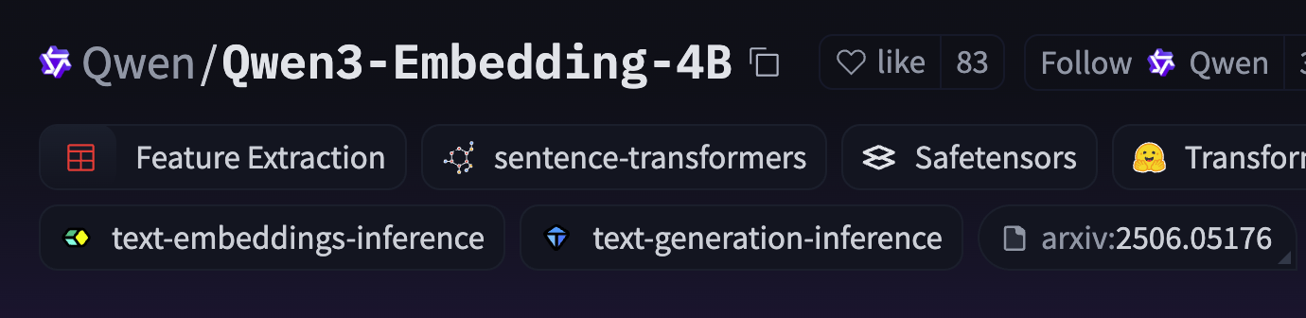
RAG (Retrieval augmented generation)
https://huggingface.co/spaces/mteb/leaderboard

Slide 45
Limitations
Hallucinations: They can generate incorrect information confidently
Lack of true understanding: They lack true understanding of the world and operate purely on statistical patterns
Bias: They may reproduce biases present in their training data or inputs.
Context windows: They have limited context windows (though this is improving)
Computational resources: They require significant computational resources

Slide 46


Slide 47
Resources
https://huggingface.co/course
https://huggingface.co/learn/agents-course/unit0/introduction
https://www.deeplearning.ai/short-courses/langchain-chat-with-your-data/
https://www.youtube.com/@AndrejKarpathy
https://www.manning.com/books/build-a-large-language-model-from-scratch
https://github.com/rasbt/LLMs-from-scratch

Slide 48
Resources
https://docs.vllm.ai/en/latest/usage/index.html
https://huggingface.co/blog
https://jalammar.github.io/illustrated-transformer/
https://www.deeplearning.ai/short-courses/how-transformer-llms-work/
https://github.com/unslothai/unsloth
https://github.com/KalyanKS-NLP/llm-engineer-toolkit

Slide 49
Thank you!!! Any questions???

